Slide 1
Yassir eta prediction app

Slide 2
Agenda
Introduction
Issues encountered
Models and features
RSME
WebApp interface

Slide 3

INTRODUCTION
The Yassir Ride Hailing Company is an Algerian company with an objective of being able to accurately predict estimated time of arrival of customers to their destination.
This is a good marketing point since customers can plan with our cars in their everyday dealings.

Slide 4

Issues encountered
The Latitude and Longitude are interchanged pointing to Kenya
Weather data and trip distance alone is not enough to accurately predict ETA.
Other factors like road terrain,speed limits in cities, and number of traffic lights will greatly improve the models

Slide 5
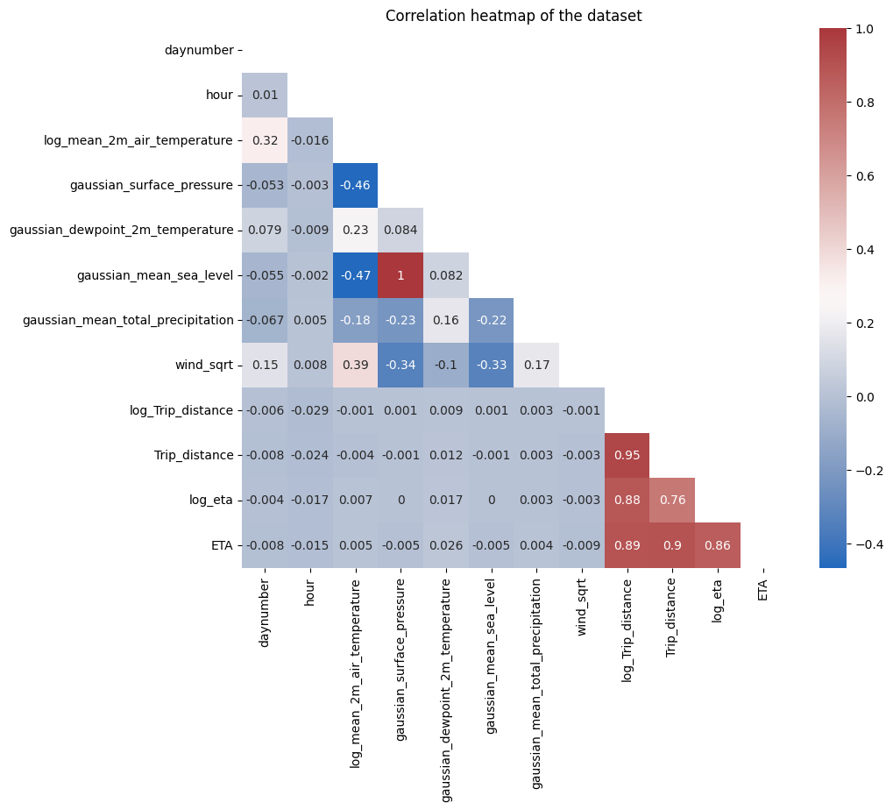
FEATURES of interest

Slide 6
FEATURES of interest
Mean_2m_air_temperature,Trip_distance,surface_pressure,mean_sea_level and dewpoint_2m_temperature were the features considered in building this model.
The log of these features was calculated and this gave a better correlation with ETA .
A gaussian filter applied to smoothen individual feature curves to improve prediction.

Slide 7
MODELs AND FEATURES
Models considered for the project are
Linear Regression
KN-Neighbours
Xgboost regressor
LGBM regressor
Support Vector Regression

Slide 8
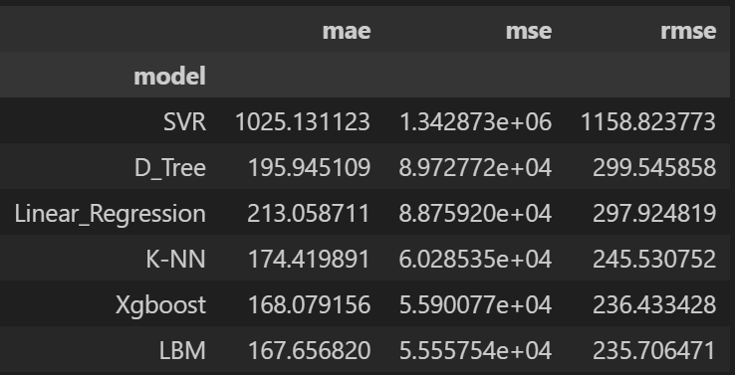
rsme

Slide 9
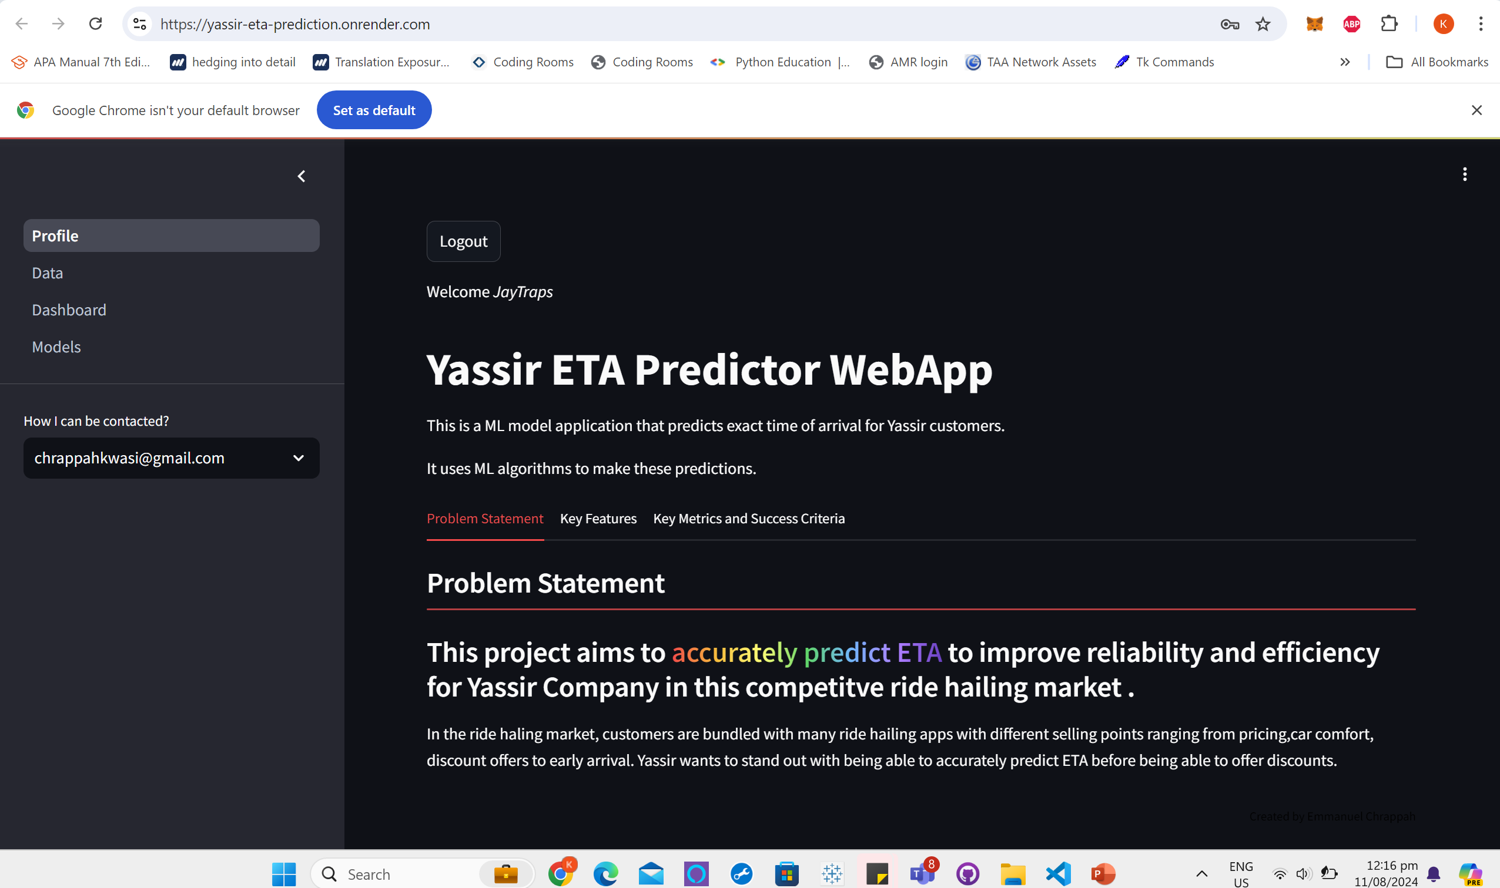
WebApp interface

Slide 10
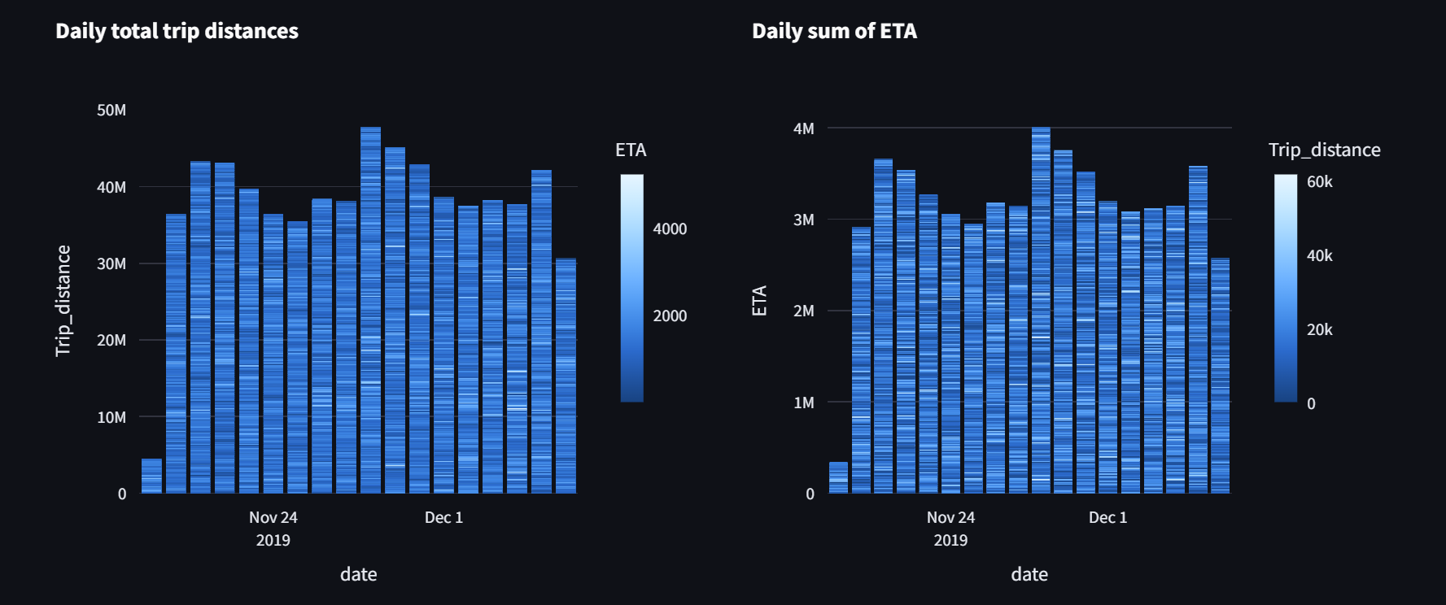
WebApp interface

Slide 11
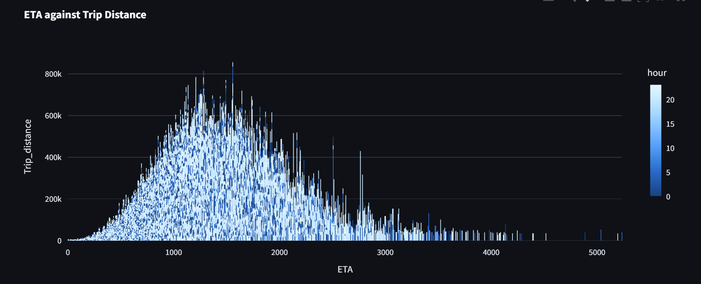
WebApp interface

Slide 12

WebApp interface

Slide 13
THANK YOU

